Slide 1
CS 253: Algorithms
Chapter 11
Hashing
Credit: Dr. George Bebis

Slide 2
The Search Problem
Find items with keys matching a given search key
Given an array A, containing n keys, and a search key x, find the index i such that x=A[i]
a key could be part of a large record.
Applications
Banking: Keeping track of customer account information
Search through records to check balances and perform transactions
Flight reservations: Search to find empty seats, cancel/modify reservations
Search engine: Looks for all documents containing a given word

Slide 3
Dictionaries
Dictionary = data structure that supports the basic operations: insert, delete and search an item (based on a given key)
Queries: return information about the set S:
Search (S, k)
Minimum (S), Maximum (S)
Successor (S, x), Predecessor (S, x)
Operations that modify a given set
Insert (S, k)
Delete (S, k) – not very often

Slide 4
Direct Addressing
If key values are distinct and drawn from a universe U = {0, 1, . . . , m - 1}
You may use Direct-address table representation:
An array T[0 . . . m - 1]
Each slot, or position, in T corresponds to a key in U
For an element x with key k, a pointer to x (or x itself) will be placed in location T[k]
If there are no elements with key k in the set, T[k] points to a NIL

Slide 5
Operations
Alg.: DIRECT-ADDRESS-SEARCH(T, k)
return T[k]
Alg.: DIRECT-ADDRESS-INSERT(T, x)
T[key[x]] ← x
Alg.: DIRECT-ADDRESS-DELETE(T, x)
T[key[x]] ← NIL
Running time for these operations: O(1)

Slide 6
Comparing Different Implementations
Implementing dictionaries using:
Direct addressing
Ordered/unordered arrays
Ordered/unordered linked lists
Insert
Search
direct addressing
O(1)
O(1)
ordered array
O(N)
O(lgN)
ordered list
O(N)
O(N)
unordered array
O(1)
O(N)
unordered list
O(1)
O(N)

Slide 7
Examples Using Direct Addressing
Example 1:
Example 2:
Suppose that the keys are 9-digit Social Security Numbers
We can use the same strategy as before but it will be very inefficient.
An array of 1 Billion items is needed to store 100 records !!
|U| (size of the entire key universe) can be very large
|K| (actual set of keys) can be much smaller than |U|

Slide 8
Hash Tables
When K is much smaller than U, a hash table requires much less space than a direct-address table
Can reduce storage requirements to |K|
and still get O(1) search time on average (not the worst case)
Idea:
Use a function h(.) to compute the slot for each key
Store the element in slot h(k)
A hash function h transforms a key into an index in a hash table T[0…m-1]. h : U → {0, 1, . . . , m - 1}
We say that k hashes to slot h(k)
Advantages:
Reduce the range of array indices handled: m instead of |U|

Slide 9
Revisit Example 2
Suppose that the keys are 9-digit Social Security Numbers
One possible hash function:
h(ssn) = ssn mod 100 (last 2 digits of ssn)
e.g. If ssn = 108 334 198 then h(108334198) = 98
0
U
(universe of keys)
h(k₁)
h(k₄)
k₁
K
(actual
keys)
h(k₂)
k₄
k₂
h(k₂) = h(k₅)
k₅
k₃
h(k₃)
m - 1
Do you see any problems with this approach?
Collisions can occur!

Slide 10
Collisions
Two or more keys hash to the same slot!!
For a given set K of keys
If |K| > m, collisions will definitely happen (i.e., there must be at least two keys that have the same hash value)
If |K| ≤ m, collisions may or may not happen
Avoiding collisions completely is hard, even with a good hash function
Handling Collisions:
Chaining
Open addressing
Linear probing
Quadratic probing
Double hashing

Slide 11
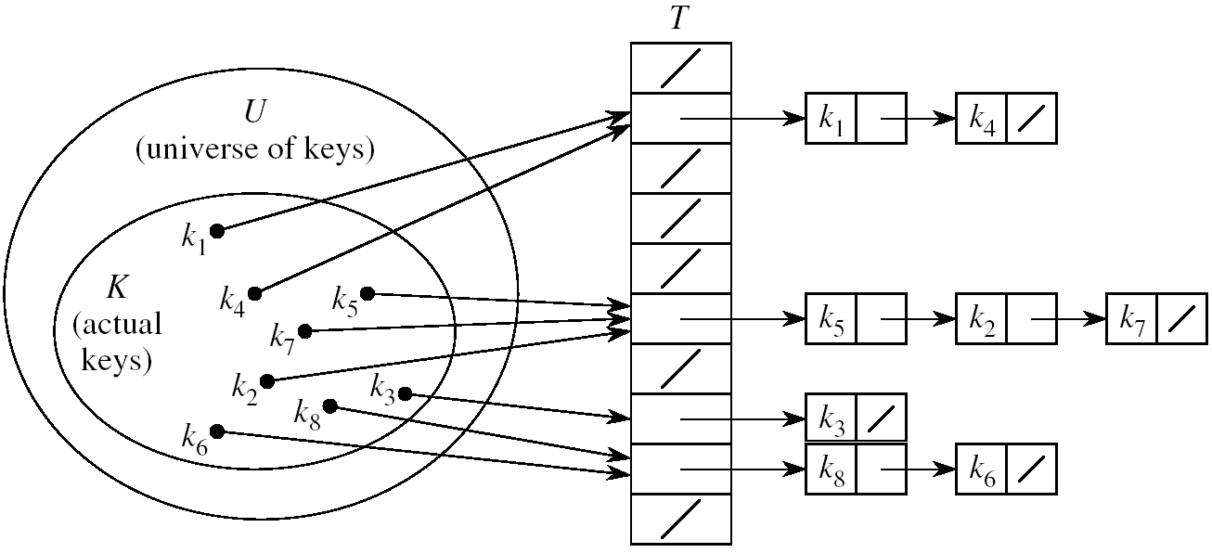
Handling Collisions Using Chaining
Idea:
Put all elements that hash to the same slot into a linked list
Slot j contains a pointer to the head of the list of all elements that hash to j

Slide 12
Operations in Chained Hash Tables
Alg.: CHAINED-HASH-INSERT(T, x)
insert x at the head of list T[h(key[x])]
Worst-case running time is O(1)
Note that you may also need to search to check if it is already there
Alg.: CHAINED-HASH-SEARCH(T, k)
search for an element with key k in list T[h(k)]
Running time is proportional to the length of the list of elements in slot h(k)
Alg.: CHAINED-HASH-DELETE(T, x)
delete x from the list T[h(key[x])]
Worst-case running time is the same as the search operation

Slide 13
Analysis of Hashing with Chaining: Average Case
Worst case: All n keys hash to the same slot.
Then search/delete operations may take Θ(n)
Average case depends on how well the hash function distributes the n keys among the m slots
Simple uniform hashing: Any given element is equally likely to hash into any of the m slots
(i.e. when T is empty, collision probability Pr(h(x)=h(y)), is 1/m)
Length of a list: n_{j}, j = 0, 1, . . . , m – 1
Number of keys in the table: n = n₀ + n₁ +· · · + n_{m-1}
Average value of n_{j}: E[n_{j}] = α = n/m
Load factor of a hash table T: α = n/m
α = the average number of elements stored in a chain
T
n₀ = 0
n₂
n₃
n_{j}
n_{k}
n_{m-1} = 0

Slide 14
Case 1: Unsuccessful Search (i.e. item not stored in the table)
Theorem:
An unsuccessful search in a hash table takes expected time Θ(1+ α) under the assumption of simple uniform hashing (i.e. Given any random x and y, probability of collision Pr(h(x)=h(y)), is 1/m)
Proof :
need to search to the end of the list T[h(k)]
Expected length of the list: E[n_{h(k)}] = α = n/m
Total time required : O(1) (to compute h(k)) + α → Θ(1+ α)

Slide 15
Case 1I: Successful Search (i.e. item found in the table)
A successful search in a hash table takes expected time
Θ(1+ α/2) under the assumption of simple uniform hashing
where α = n/m (expected length of the list)
If m (# of slots) is proportional to n (# of elements in the table):
n = O(m) ➔ α = n/m = O(m)/m = O(1)
➔ Searching (both successful and unsuccessful)
takes constant time O(1) on average

Slide 16
Hash Functions
What makes a good hash function?
Easy to compute
Approximates a random function: considering all the keys, every output
is equally likely (simple uniform hashing)
In practice, it is very hard to satisfy the simple uniform hashing property i.e. , we don’t know in advance the probability distribution that keys are drawn from
Minimize the chance that closely related keys hash to the same slot (i.e. strings such as pt and pts should hash to different slots)
Derive a hash value that is independent from any patterns that may exist in the distribution of the keys

Slide 17
The Division Method
Idea:
Map a key k into one of the m slots by taking the remainder of k divided by m
h(k) = k mod m
Advantage: fast, requires only one operation
Certain values of m are bad, e.g. power of 2 or non-prime numbers
If m = 2^{p} then h(k) is just the least significant p bits of k
Choose m to be a prime, not close to a power of 2

Slide 18
The Multiplication Method
h(k) = ⎣m (k A - ⎣k A⎦)⎦ 0 < A < 1
fractional part of kA
Disadvantage: Slower than division method
Advantage: Value of m is not critical, e.g., typically 2^{p}
EXAMPLE: m = 2³
.101101 (A)
110101 (k) (kA) = 1001010.0110011
Discard integer part: 1001010
Shift .0110011 by 3 bits to the left ➔ 011.0011
Take integer part: 011
Thus, h(110101) = 011

Slide 19
Open Addressing
If we have enough contiguous memory to store all the keys (m > N) ➔ store the keys in the table itself
No need to use linked lists anymore
Insertion: if a slot is full, try another one,
until you find an empty one
Search: follow the same sequence of probes
Deletion: more difficult ... (we’ll see why)
Search time depends on the length of the
probe sequence!
e.g., insert 14

Slide 20
Generalized hash function notation:
A hash function contains two arguments now:
(i) Key value, and (ii) Probe number
h(k,p), p=0,1,...,m-1
Probe sequences
<h(k,0), h(k,1), ..., h(k,m-1)>
Must be a permutation of <0,1,...,m-1>
There are m! possible permutations
An optimum hash function has potential to
produce all m! probe sequences
insert 14
Example: <1, 5, 9>

Slide 21
Common Open Addressing Methods
Linear probing
Quadratic probing
Double hashing

Slide 22
Linear probing: Inserting a key
Idea: when there is a collision, check the next available position in the table (i.e., probing)
h(k,i) = (h₁(k) + i) mod m i=0,1,2,...
First slot probed: h₁(k)
Second slot probed: h₁(k) + 1
Third slot probed: h₁(k)+2, and so on
probe sequence: < h₁(k), h₁(k)+1 , h₁(k)+2 , ....>
Can generate m probe sequences maximum, why?
wrap around

Slide 23
Linear probing: Searching for a key
Four cases:
Position in table is occupied with an element of equal key
Position in table is marked as ‘deleted’
Position in table occupied with a different element
Position in table is empty
Cases 2 or 3: probe the next higher index until the element is found or an empty position is found
The process wraps around to the beginning of the table
0
h(k₁)
h(k₄)
h(k₂)=h(k₅)
h(k₃)
m - 1

Slide 24
Linear probing: Deleting a key
Problems
Cannot mark the slot as empty
Otherwise, impossible to retrieve those keys inserted when that slot was occupied
Solution
Mark the slot with a sentinel value DELETED
The deleted slot can later be used for insertion
0
m - 1

Slide 25
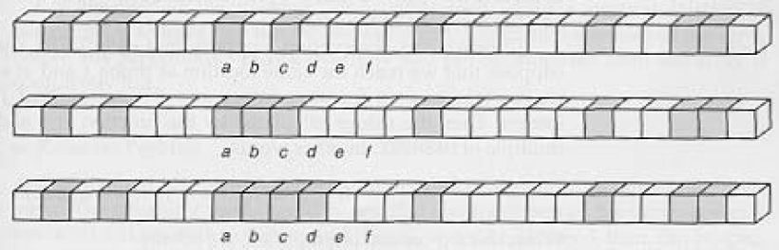
Primary Clustering Problem
Some slots become more likely than others
Long chunks of occupied slots are created
⇒ search time increases!
initially, all slots have probability 1/m
Slot b:
2/m
Slot d:
4/m
Slot e:
5/m

Slide 26
Quadratic probing
h(k,i) = (h’(k)+c₁i + c₂i²) mod m, i = 0, 1, …, m-1
where h’: U →(0,1,…, m-1), c₁, c₂ > 0
Clustering problem is less serious but still an issue (secondary clustering)
How many distinct probe sequences quadratic probing generate?
(the initial probe position determines the probe sequence)
m

Slide 27
Double Hashing
Use one hash function to determine the first slot
Use a second hash function to determine the increment for the probe sequence
h(k,i) = (h₁(k) + i h₂(k)) mod m, i=0,1,...
Initial probe: h₁(k)
Second probe is offset by h₂(k) mod m, so on ...
Advantage: avoids clustering
Disadvantage: harder to delete an element
Can generate m² probe sequences maximum. Why?
(For two different keys k_{a} and k_{b}, even if h₁(k_{a})=h₁(k_{b}), it is unlikely that h₂(k_{a})=h₂(k_{b}), therefore two keys that initially probe to the same location may generate different probe sequences. Furthermore, after the initial probe, increment could be 1, or 2, or 3, or …m each one resulting in a unique probe sequence – a total of m. There are m initial probes each may in turn generate m sequences ➔ A total of m*m= m² sequences )

Slide 28
Double Hashing: Example
h₁(k) = k mod 13
h₂(k) = 1+ (k mod 11)
h(k,i) = (h₁(k) + i h₂(k) ) mod 13
Insert key=14:
h₁(14,0) = 14 mod 13 = 1
h(14,1) = (h₁(14) + h₂(14)) mod 13
= (1 + 4) mod 13 = 5
h(14,2) = (h₁(14) + 2 h₂(14)) mod 13
= (1 + 8) mod 13 = 9
0
79
69
98
72
50
1
2
3
4
5
6
7
8
9
14
10
11
12

Slide 29
Analysis of Open Addressing
Theorem 11.6: Given an open-address hash table with load factor
α = n/m < 1, the expected number of probes in an unsuccessful search is at most 1/(1- α), assuming uniform hashing
Proof: Ignore the problem of clustering and assume that all probe sequences are equally likely, then
Unsuccessful search analysis:
Probability(probe hits an occupied cell) = α (load factor α = n/m)
Prob(probe hits an empty cell) = 1- α
probability that a probe terminates in 2 steps = α(1-α)
probability that a probe terminates in k steps = α^{k-1}(1-α)
What is the average number of steps in a probe?

Slide 30
Analysis of Open Addressing (cont’d)
Successful search:
Example
Unsuccessful probe:
α = 0.5 E(#steps) = 2
α = 0.9 E(#steps) = 10
Successful probe:
α = 0.5 E(#steps) = 1.386
α = 0.9 E(#steps) = 2.558

